Slide 1


Slide 2
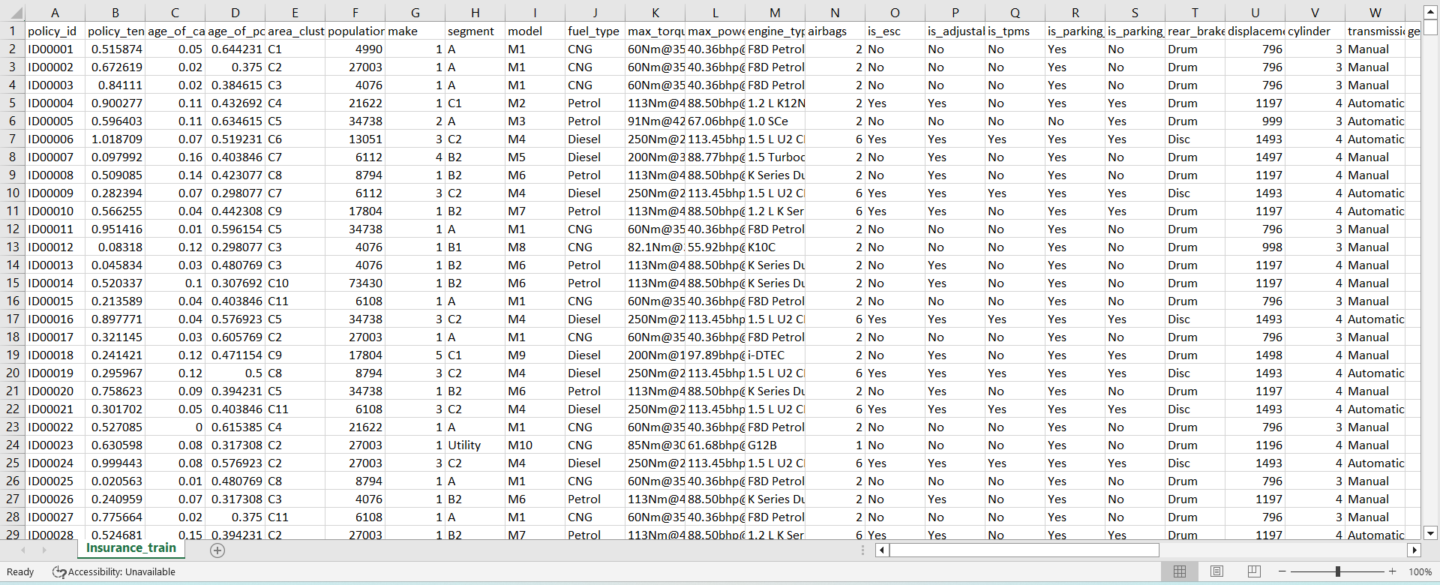
Data Shared
Task: Classification
Training Set: 58592 rows, 43 predictors
Test Set: 39063 rows, 43 predictors
EDA:
All predictors are mix of categorical and numerical data type.
No Missing values or Duplicate rows.
Policy_id is unique id column so it can be removed.
Target variable is categorical and it is imbalanced.

Slide 3
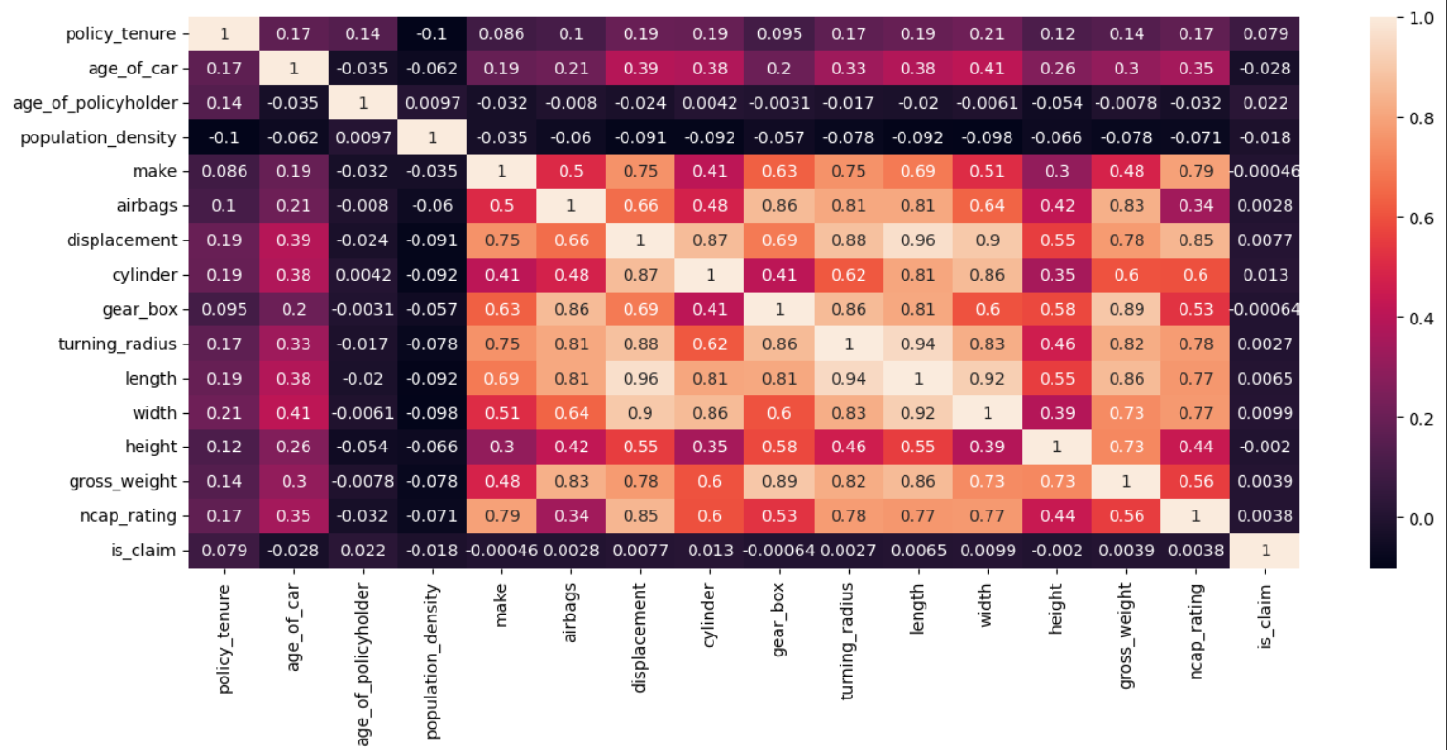
VISUALIZATION
No much correlation between target and predictor variables
There are some high correlations among predictor variables i.e length and displacement.

Slide 4
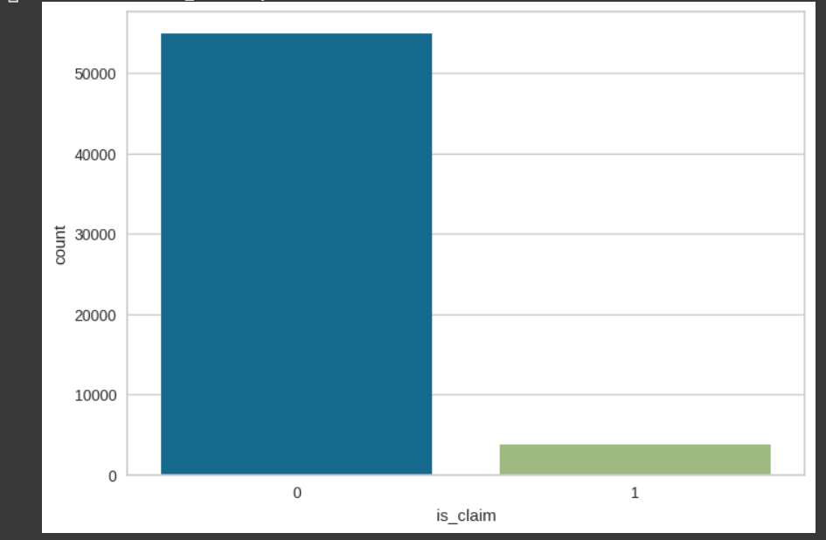
VISUALIZATION
Clear Imbalance of Target variable.
Model F1-score or precision or recall must be the metrics to determine model performance.
Accuracy is not the good measure.

Slide 5
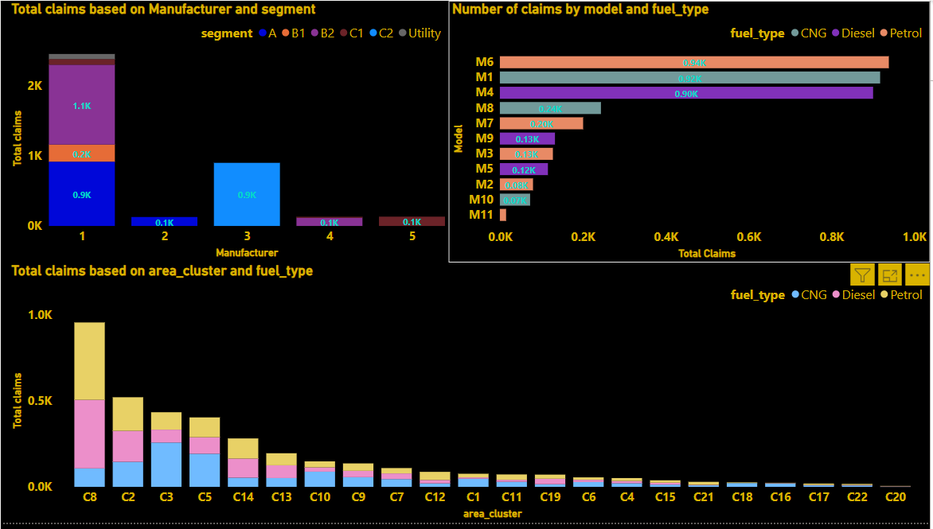
VISUALIZATION
Power BI sheet for visualization

Slide 6
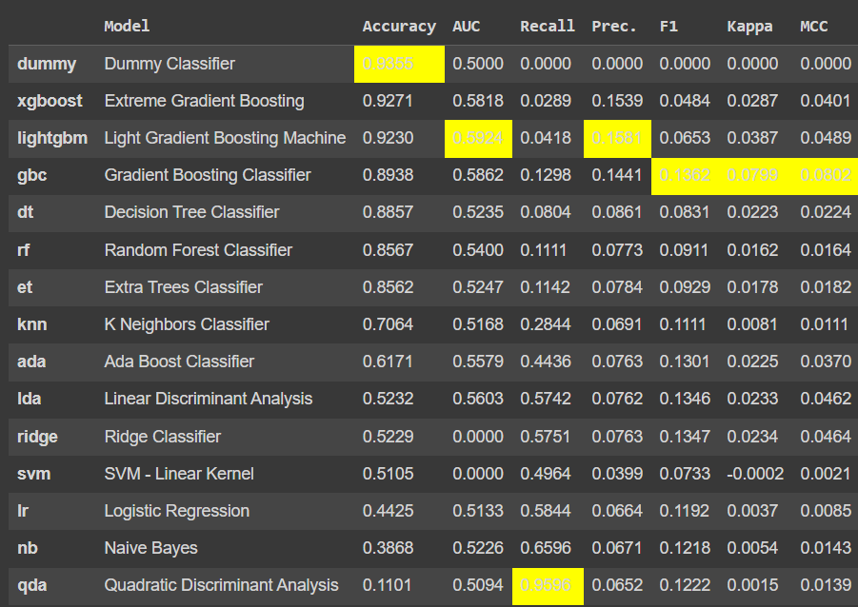
Model Building- Pycaret AutoML
From the metrics considering F1 score Gradient Boost classifier is better compared to other models

Slide 7
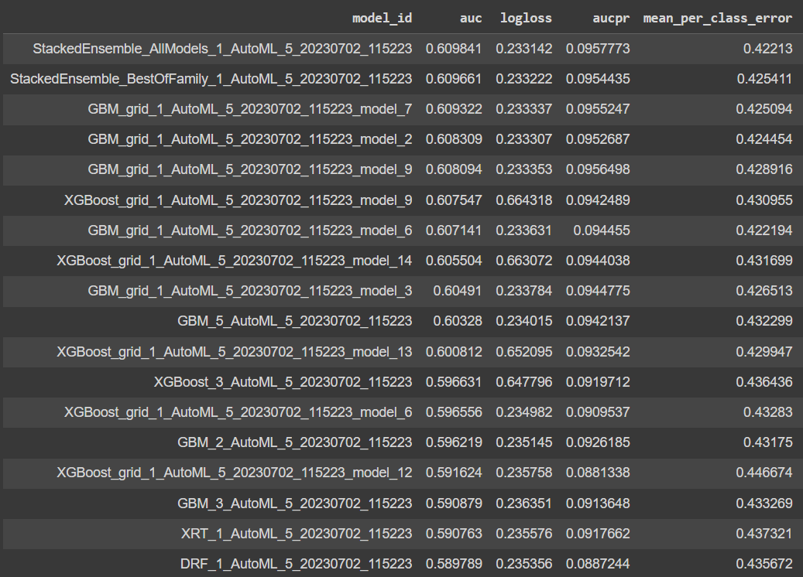
Model Building- H2O AutoML
Stacked Ensemble Model has better AUC compared to other models

Slide 8
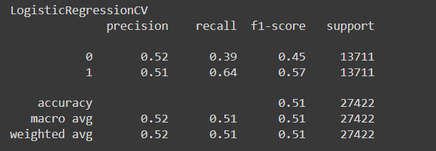
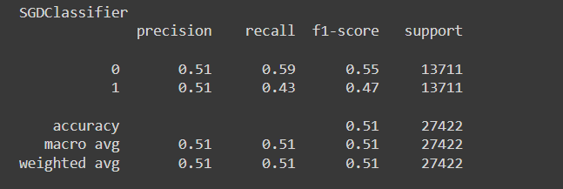
Model Building-With sampling done before train test split
Logistic Regression
SGD classifier
F1-score for both models is +- 10 for both classes

Slide 9
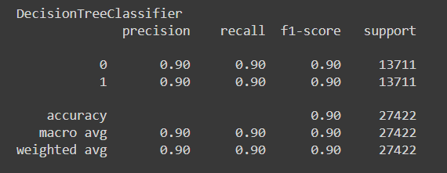
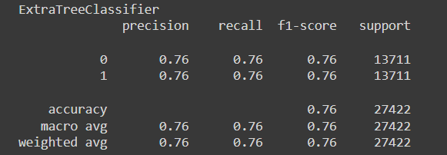
Model Building-With sampling done before train test split
Decision Tree
SGD classifier
Decision Tree model performed better compared to Extra Tree classifier

Slide 10
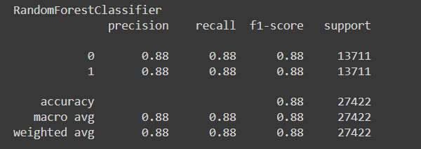
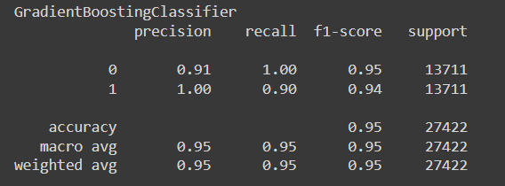
Model Building-With sampling done before train test split
Random Forest
Gradient Boost
Gradient Boost model performed better compared to Random Forest classifier

Slide 11
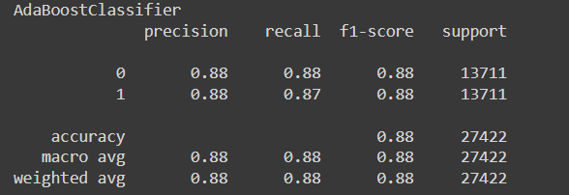
Model Building-With sampling done before train test split
Ada Boost

Slide 12
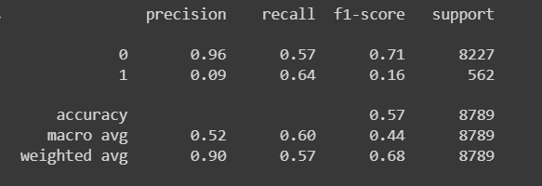
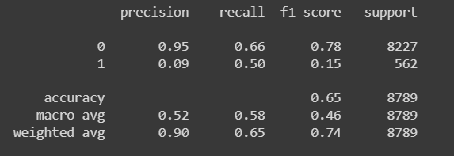
Model Building-With sampling done after train test split
Decision Tree
Random Forest

Slide 13
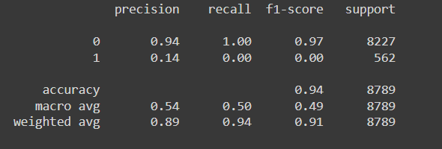
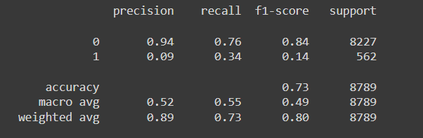
Model Building-With sampling done after train test split
XGBoost
AdaBoost

Slide 14
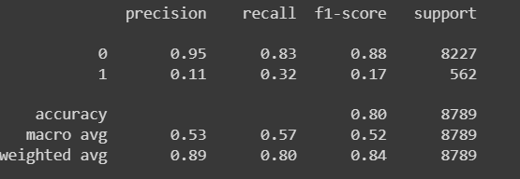
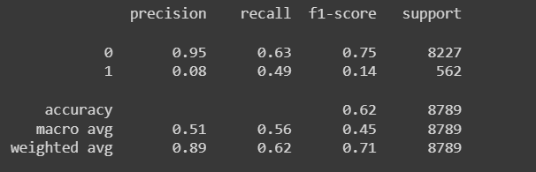
Model Building-With sampling done after train test split
Gradient Boost
Naïve Bayes
Gradient Boost performed better compared to other model

Slide 15
Model Comparison
MODEL | Precision | Recall | F1-Score | Accuracy | AUC
Logistic Regression CV | 0 – 0.52 1 – 0.51 | 0 – 0.39 1 – 0.64 | 0 – 0.45 1 – 0.57 | 0.51 | 0.51
SGD Classifier | 0 – 0.51 1 – 0.51 | 0 – 0.59 1 – 0.43 | 0 – 0.55 1 – 0.47 | 0.51 | 0.51
Decision Tree | 0 – 0.90|0.96 1 – 0.90|0.09 | 0 – 0.90|0.57 1 – 0.90|0.64 | 0 – 0.90|0.71 1 – 0.90|0.16 | 0.90|0.57 | 0.90
Random Forest | 0 – 0.88|0.95 1 – 0.88|0.09 | 0 – 0.88|0.66 1 – 0.88|0.50 | 0 – 0.88|0.78 1 – 0.88|0.15 | 0.88|0.65 | 0.87
Extra Tree | 0 – 0.76 1 – 0.76 | 0 – 0.76 1 – 0.76 | 0 – 0.76 1 – 0.76 | 0.76 | 0.76
Gradient Boost | 0 – 0.91|0.95 1 – 1.0 |0.11 | 0 – 1.0|0.83 1 – 0.91|0.32 | 0 – 0.95|0.88 1 – 0.94|0.17 | 0.95|0.80 | 0.94
Ada Boost | 0 – 0.88|0.94 1 – 0.88|0.09 | 0 – 0.88|0.76 1 – 0.87|0.34 | 0 – 0.88|0.84 1 – 0.88|0.14 | 0.88|0.73 | 0.87

Slide 16
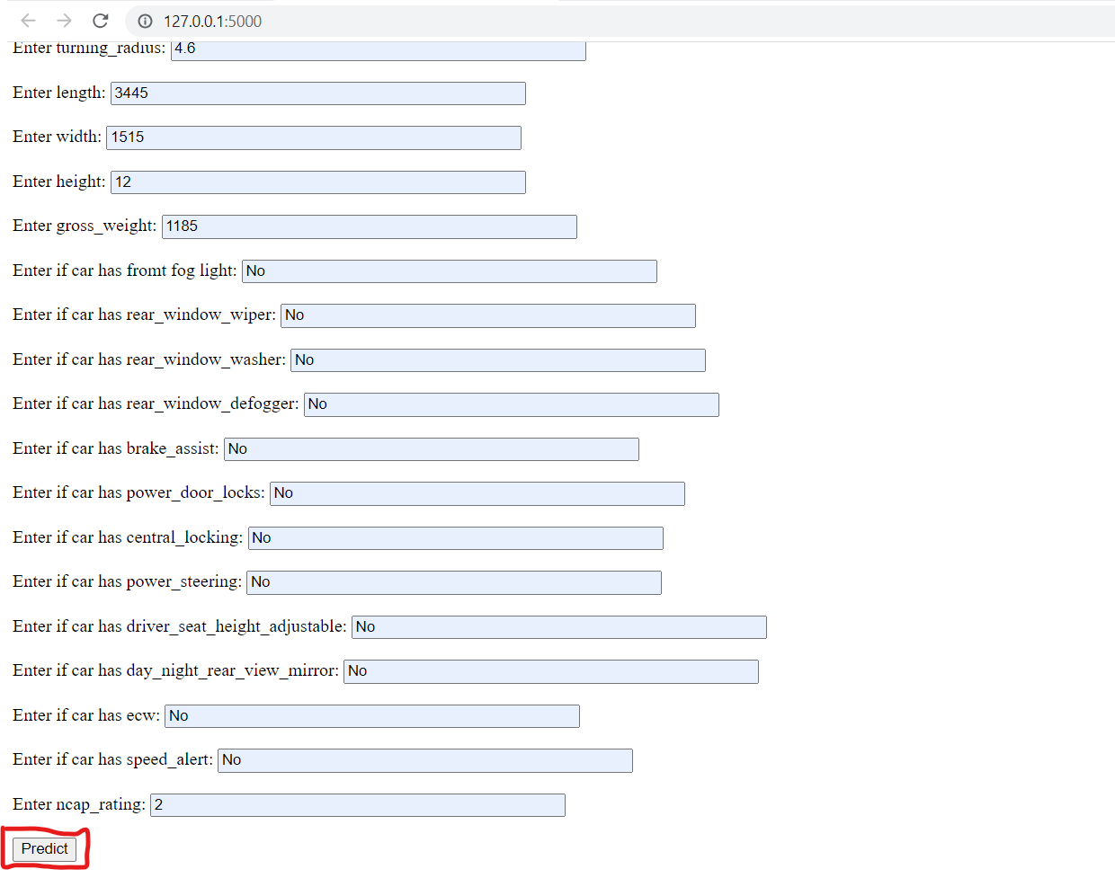
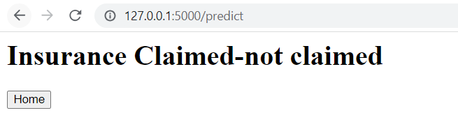
Flask App Deployment
By Clicking the predict button after giving all inputs whether the person might claim or not will be displayed.

